Slide 1
Lesson 12
The transfiguration
July 8, 2020
The Transfiguration
Matthew 17:1-13; Mark 9:2-13; Luke 9:28-36

Slide 2
The transfiguration
Matthew 17:1-13; Mark 9:2-13; Luke 9:28-36
“Six days later Jesus took with Him Peter and James and John his brother, and led them up on a high mountain by themselves. And He was transfigured before them; and His face shone like the sun, and His garments became as white as light. And behold, Moses and Elijah appeared to them, talking with Him.” (Matthew 17:1-3)
“Transfigured” – from the Greek metamorphoo from where we get the word “metamorphosis.”
We should call to mind the change we are to experience (Romans 12:1-2; 2 Corinthians 3:18) and the change we yet hope to experience
(1 Corinthians 15:50-53)
Notes:
Imagine what the apostles must be thinking about after first, Jesus’ response to Peter’s declaration that Jesus is the Messiah, then the Lord’s revelation of His death, and then Jesus teaching about true discipleship and the need to follow Him through personal sacrifice, self denial and service.
Meta - means change; morphe - means form.
NT:3339
Rom 12:2, "be ye transformed," the obligation being to undergo a complete change which… will find expression in character and conduct;
morphe lays stress on the inward change, schema (see the preceding verb in that verse, suschematizo) lays stress on the outward (see FASHION, No. 3, FORM, No. 2); the present continuous tenses indicate a process; 2 Cor 3:18 describes believers as being "transformed (RV) into the same image" (i. e., of Christ in all His moral excellencies), the change being effected
(from Vine's Expository Dictionary of Biblical Words, Copyright © 1985, Thomas Nelson Publishers.)
2 Cor 3:18
But we all, with unveiled face, beholding as in a mirror the glory of the Lord, are being transformed into the same image from glory to glory, just as from the Lord, the Spirit.

Slide 3
The transfiguration
Matthew 17:1-13; Mark 9:2-13; Luke 9:28-36
The 2nd event in which only Peter, James, and John were allowed to take part:
The healing of Jairus’ daughter. (Mark 5:37)
The transfiguration (“to pray,” Luke 9:28)
Jesus praying in the garden of Gethsemane. (“to pray,” Mark 14:33-35)
Why these three? (2 Peter 1:16-18)
Which mountain?
Notes:
At any rate, the special inclusion of these men in no way reflected partiality on the part of Jesus. Just as different people serve different roles in the church and in the home, these men played a special role in these events in the life of Jesus. Coffman notes, “Matthew was omitted from that inner circle of three disciples who witnessed the marvel here related, and one can find only amazement at the complete detachment and objectivity of his narrative” (Pope, Truth Commentary)
The most likely candidate is Mount Hermon, the tallest mountain in Palestine near Caesarea Philippi, the last location mentioned in the text (16:13-16). 9200 feet high.
Was the transfiguration a response to Jesus’ prayer in Luke 9:28 as He prepared by faith to lay down His life? Jesus’ betrayal, suffering and crucifixion are clearly on His mind.

Slide 4
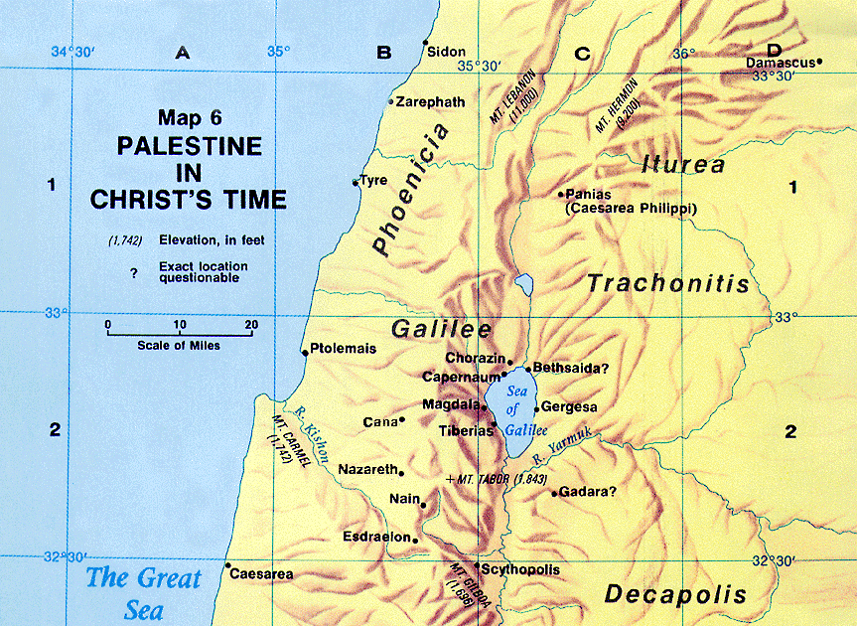

Slide 5
The transfiguration
Matthew 17:1-13; Mark 9:2-13; Luke 9:28-36
“Transfigured” –
“His face shone like the sun.” (Matthew 17:2)
“His garments became as white as light.”
(Note Mark’s description in Mark 9:3)
Luke does not use the word “transfigured” but simply states “the appearance of His face became different, and His clothing … white … gleaming.”
We see Jesus described in heavenly glory!
(John 17:5; cf. 1 Timothy 6:16)
Noted by other spiritual beings observed by man. (Luke 24:4; Revelation 1:16)
Notes:
Footnote for Luke 9:29; “lit. flashing like lightning.” NT:1823 - “properly, to send forth lightning, to lighten. 2. to flash out like lightning, to shine, be radiant: of garments, Luke 9:29. (from Thayer's Greek Lexicon, Electronic Database. Copyright © 2000, 2003, 2006 by Biblesoft, Inc. All rights reserved.)
Unlike anything else… point of Mark 9:3 “as no launderer on earth can whiten them.”
Again emphasize what was changed was the form (morphe) “the distinctive nature and character of an object” and the fashion (schema) “the changeable outword fashion”.
Vincent argues that this indicates that in Christ being transfigured (metamorph□th), “the visible change gets its real character and meaning from that which is essential in our Lord—his divine nature” (100).
“In the transfiguration, to some degree the glorious divine nature of Jesus was allowed to shine forth for a time.” Pope.
1 Tim 6:15-16 - which He will bring about at the proper time — He who is the blessed and only Sovereign, the King of kings and Lord of lords, 16 who alone possesses immortality and dwells in unapproachable light, whom no man has seen or can see. To Him be honor and eternal dominion! Amen.

Slide 6
The transfiguration
Matthew 17:1-13; Mark 9:2-13; Luke 9:28-36
“And behold, two men were talking with Him; and they were Moses and Elijah, who, appearing in glory, were speaking of His departure which He was about to accomplish at Jerusalem.” (Luke 9:30-31)
Moses – representative of the Law.
Elijah – representative of the prophets.
Jesus is superior to both! (Luke 16:16; John 1:45)
Notes:
Jesus was “transfigured” or changed. Moses and Elijah simply appeared in their spiritual state..
OT revelation as a whole was described with the phrase the Law and the Prophets (5:17; 7:12; 11:13; Luke 16:16; John 1:45; Acts
13:15; 24:14; 28:23; Rom. 3:21)

Slide 7
The transfiguration
Matthew 17:1-13; Mark 9:2-13; Luke 9:28-36
What were they talking about? Jesus’ “departure which He was about to accomplish at Jerusalem.” (Luke 9:31)
“Departure” from the Greek “exodus” (2 Peter 1:15; Matthew 16:21; Luke 24:27, “Then beginning with Moses and with all the prophets, He explained to them the things concerning Himself in all the Scriptures.”)
“Accomplish” – “to make replete… satisfy, execute …” (Strong) “To complete …” (Thayer) (John 17:4; 19:30)
“But the things which God announced beforehand by the mouth of all the prophets, that His Christ would suffer, He has thus fulfilled.” (Acts 3:18; cf. 17:3)
Complete the prophecies concerning His crucifixion. (Psalms 22; Isaiah 53; cf. Luke 24:44).
Notes:
Departure or exodus? His death and resurrection? His ascension?
In Luke 24, go back to verse 21 and bring up to vs. 27.
We obviously don’t know the exact words they said but it seems clear this was a response to Jesus prayer to His Father. Not as some suggest to reveal God’s scheme to save man (1 Peter 1:10-12)
2 Peter 1:15 - And I will also be diligent that at any time after my departure you will be able to call these things to mind.
Acts 3:18 - But the things which God announced beforehand by the mouth of all the prophets, that His Christ would suffer, He has thus fulfilled.
Acts 17:2-3 - And according to Paul's custom, he went to them, and for three Sabbaths reasoned with them from the Scriptures, 3 explaining and giving evidence that the Christ had to suffer and rise again from the dead, and saying, "This Jesus whom I am proclaiming to you is the Christ.“
Luke 24:44 - These are My words which I spoke to you while I was still with you, that all things which are written about Me in the Law of Moses and the Prophets and the Psalms must be fulfilled."

Slide 8
The transfiguration
Matthew 17:1-13; Mark 9:2-13; Luke 9:28-36
This happened “while” Jesus was praying.
(Luke 9:29; cf. Mark 14:32)
“Peter and his companions” had been “overcome with sleep” (Luke 9:32; cf. Mark 14:37)
Peter, James, and John awoke to the scene of Jesus in “His glory and the two men standing with them.” (Luke 9:32)
For what purpose? A response to Jesus’ prayer?
Encouragement and strength? (Luke 22:41-43) Remember what Jesus had just revealed to His apostles! (Matthew 16:21)
Honor and glory to Jesus. (2 Peter 1:16-18)
Notes:
We obviously don’t know the exact words they said but it seems clear this was a response to Jesus prayer to His Father. Not as some suggest to reveal God’s scheme to save man (1 Peter 1:10-12)
Remember, Jesus literally had the weight of the world on His shoulders.

Slide 9
2 Peter 1:16-18
“For we did not follow cleverly devised tales when we made known to you the power and coming of our Lord Jesus Christ, but we were eyewitnesses of His majesty. For when He received honor and glory from God the Father, such an utterance as this was made to Him by the Majestic Glory, ‘This is My beloved Son with whom I am well-pleased’ – and we ourselves heard this utterance made from heaven when we were with Him on the holy mountain.”

Slide 10
The transfiguration
Matthew 17:1-13; Mark 9:2-13; Luke 9:28-36
Peter’s response:
“As these men were leaving Him …” (Luke 9:33)
“… Master, it is good for us to be here; let us make three tabernacles: one for You, and one for Moses, and one for Elijah” (Luke 9:33)
Note that Matthew records the address to Jesus as “Lord” and in Mark as “Rabbi.”

Slide 11
The transfiguration
Matthew 17:1-13; Mark 9:2-13; Luke 9:28-36
Peter’s response:
“It is good for us to be here …” “Pleasant, desirable, advantageous” (Arndt and Gingrich). We don’t want such times to end!
“… If you wish, I will make three tabernacles here, one for You, one for Moses, and one for Elijah.”
  Is Peter learning to “follow” Jesus as he asks, “if You wish”?
Three tabernacles: a sacred place for each to dwell. Peter is treating the three as equals.

Slide 12
The transfiguration
Matthew 17:1-13; Mark 9:2-13; Luke 9:28-36
Why did Peter say this?
“For he did not know what to answer; for they became terrified.” (Mark 9:6)
“… not knowing what he said.” (Luke 9:33; cf. James 1:19)
It’s not always necessary to say or do something!
A lot of error has been introduced under the umbrella of “we’ve got to do something” or “anything is better than nothing.”
Do Peter’s intentions matter?
Peter putting Jesus on the same level as Moses and Elijah.

Slide 13
The transfiguration
Matthew 17:1-13; Mark 9:2-13; Luke 9:28-36
God’s response came “while he was still speaking …” (Matthew 17:5) or “while he was saying this …” (Luke 9:34).
“A bright cloud overshadowed them, and behold, a voice out of the cloud said …” (Exodus 16:10; 33:9-10; Numbers 9:15ff)
Luke records (9:34) that “they were afraid as they entered the cloud” as it had “overshadow(ed)” them.
Notes:
Just like when Peter “began” to rebuke the Lord for His declaration that He would suffer and be crucified.
Psalms 2 - connects the Anointed or Messiah with the Son of God. Vs. 2 and vs. 7
Overshadow - envelope in brilliancy (Vine) envelope in a shadow (Thayer)
“Listen to Him” - contextually, what was Jesus just talking about? His suffering and crucifixion.

Slide 14
The transfiguration
Matthew 17:1-13; Mark 9:2-13; Luke 9:28-36
“This is My beloved Son, with whom I am well-pleased; listen to Him!”
Psalms 2:7; Matthew 3:17; Hebrews 1:1-8; 3:6
“Listen” – “to get by hearing, learn (from the mouth of the teacher.)” (Thayer) (Deuteronomy 18:15-19)
Again, remember the context, stop getting out in front of Jesus and get behind and follow Him.
Notes:
Just like when Peter “began” to rebuke the Lord for His declaration that He would suffer and be crucified.
Psalms 2 - connects the Anointed or Messiah with the Son of God. Vs. 2 and vs. 7
Overshadow - envelope in brilliancy (Vine) envelope in a shadow (Thayer)
“Listen to Him” - contextually, what was Jesus just talking about? His suffering and crucifixion.

